Slide 1
Blockchain By Code examples
Mario Romano
Alfresco

Slide 2


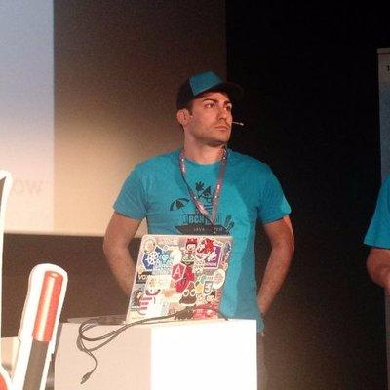



Mario Romano is the Director of Applications in Alfresco but he is still really much involved with the coding as open source contributor for various projects.
Mario Romano
Director of Applications in Alfresco
Twitter: @MagemelloMario
Notes:
Come day after tomorrow to our workshop about Activiti

Slide 3

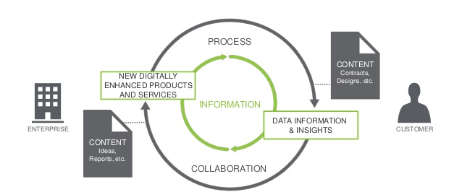


SMART AND EASY DIGITAL TRANSFORMATION
Smart
contract
CONTENT
PROCESS
Notes:
In Alfresco we want to make digital transformation smart and easy. We offer a platform, composed of ui components and rest APIs to companies that want to digitalize their content an processes.
And IF you think to content and process you can see the relation with blockchain and smart contracts….

Slide 4
Agenda
Understand what is Blockchain
Implementation of a Blockchain without network
Implementation of a Blockchain with network
Implementation of a Blockchain with network & wallet
Blockchain evolution
Demo

Slide 5

Git repo example
https://github.com/magemello/blockchain

Slide 6
WHAT IS BLOCKCHAIN?

Slide 7

Bitcoin?
…Bitcoin was the first application developed using blockchain
Notes:
Blockchain was invented by Satoshi Nakamoto to serve as the public transaction ledger of the cryptocurrency bitcoin.
Sataoshi wanted to create a database and make near impossible to remove or corrupt information in that database, he also wanted it to be transaparent and make everyone able to have a copy of that database

Slide 8

Ethereum?
Notes:
Etherium was created by Vitalik Buterin and from many people is considered the base for blockchain 2.0 & 3.0 for is ability of run scripts on the blockchain

Slide 9
…NOT JUST THAT…

Slide 10
BLOCKCHAIN IS A DISTRIBUTED SYSTEM

Slide 11
YES! COOL
…BUT WAIT SECOND…
WHAT IS A
DISTRIBUTED SYSTEM?
Notes:
And if we think about blockchain 1.0….we can say that is a distributed database

Slide 12
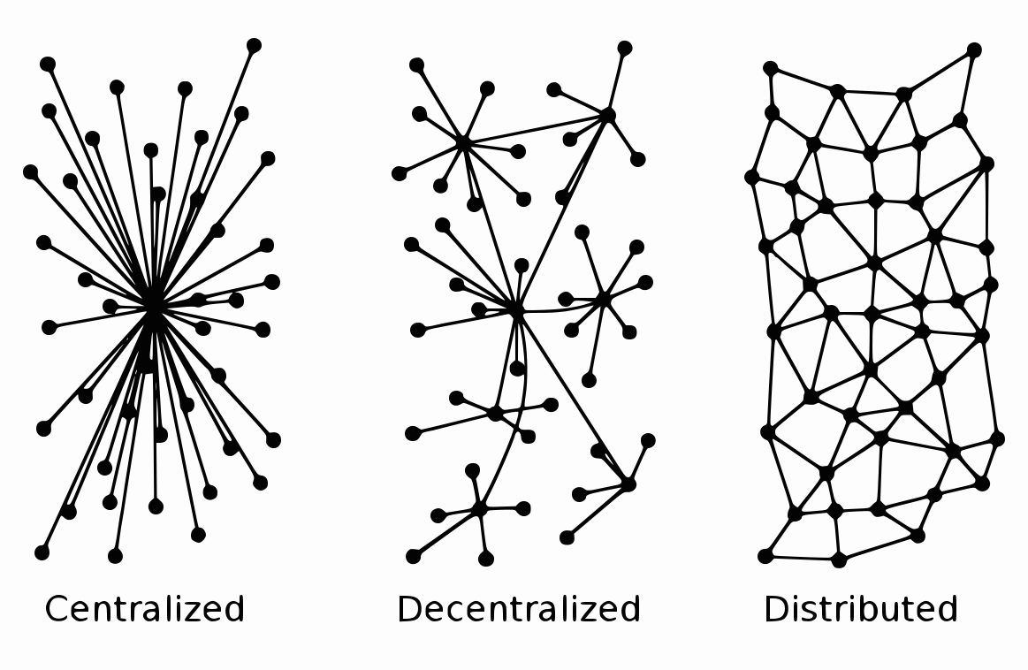
Systems architectures

Slide 13


Centralized

Slide 14
Decentralized

Slide 15
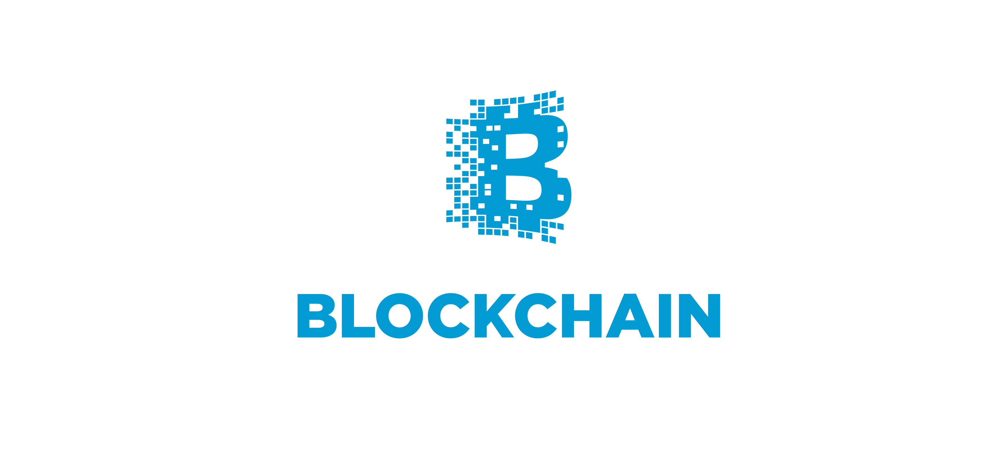
Distributed

Slide 16
CAP Theorem
CONSISTENCY
All clients see the same data at the same time
AVAILABILITY
The system continue to operate even in case of node failure
CA
X
CP
AP
PARTITION
TOLERANCE
The system continue to operate as expected even in case of partial network failure
Notes:
Availability and partition tolerance are business properties….usually business prefers sacrifice consistency and deal with it in a different way
AP

Slide 17



Blockchain phenomenon
x
x
Technology
Economy
Social
Notes:
Blochchain is more than just technology….is also a social and Economy phenomenon…but today we will not cover the social and economic part

Slide 18
TECHNOLOGY

Slide 19
Main concepts
Transaction
Digital signature
Block
Hashing
Ledger
Mining
Consensus
Smart Contracts

Slide 20


TRANSACTION
{5d60236491223ba85cf4fe0eebac35c4e457f1bb}
{ …. }

Slide 21
Transaction
A transaction represents any change in a database.
In blockchain transactions are signed with private keys
The signature of a transaction can be validated by peers using the transaction sender public key
To avoid malicious behavior and prevent reuse of the same transaction each transaction can have a unique id
{data…..}, timestamp signature
Notes:
A transaction represents any change in a database. Like in any other database blockchain stores transactions and trough them you can reconstitute the actual state.
In blockchain transactions are signed with private keys….so we can validate the authenticity of a transaction
The sign of a transaction can be validated by peers using the transaction sender public key
In our case here we will assume that the timestamp is the unique id

Slide 22





Transaction Lifecycle
{ …. }
{ …. }
{ …. }
{ …. }
Create
transaction
The transaction is
propagated to the network
The transaction is verified by the peers
The transaction is added to the pending transactions queue
The transaction
is completed
The new block is added
to the chain
New block containing the transactions is mined

Slide 23
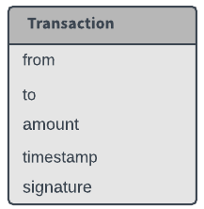
data
$ git checkout 5d60236491223ba85cf4fe0eebac35c4e457f1bb

Slide 24
DIGITAL SIGNATURE
{we don’t cover the code part in this presentation}
Notes:
How do we sign a transaction? And how do we validate it?
we don’t cover the code part in this presentation, but I will explain you how this work

Slide 25
Cryptography
Key pairs system (public key and private key)
Blockchain addresses are defined using public keys
The messages encrypted with a public key can only be decoded using the private key
Always keep the private key secret and feel free to distribute the public key

Slide 26



Asymmetric encryption
010101010101010
010101010101010
010101010101010
+
+
Mike
Alex
Alex
Public
key
Alex
Private
key
Alex
Public
key
Alex
Private
key
Alex
Public
key

Slide 27

Sign Transaction
010101010101010
{ …. }
01010100101010
{ …. }
{ …. }
+
Alex
Alex
Private
key
Alex
Public
key
Alex
Private
key
Alex
Public
key

Slide 28
Block
{fb23540fce45e0ab0f1a50f7dbb7f839561119ed}

Slide 29
Block
There is only one special Block, the genesis block
Every block is hashed
Each block contains the hash of the block generated before, in this way all the blocks are chained together
This is part of the reason why blocks are considered immutable records
Each block has a timestamp to be able to tell what and when something happened (The chain keep the history)
The hash is a unique identifier
Notes:
because the hash value of a block depends also on the hash of the previous block

Slide 30
Blockchain is a trust machine
This database is composed of a chain of blocks of data and each of them has been encrypted and has a unique identifier called hash
All the data are chained together, the hash of a block depends also on the hash of the previous block, so you can’t change one block without changing all the others.
In this way blocks become immutable records
data
data
hash
hash
genesis
block
block
block

Slide 31

Blocks
Genesis Block
Block 1
Block 2
Block Header
Block Header
Block Header
Hash
Hash Previous Block
Nonce
Timestamp
Hash
Hash Previous Block
Nonce
Timestamp
Hash
Hash Previous Block
Nonce
Timestamp
Block Data
Block Data
Block Data
[
Transaction { },
Transaction { },
Transaction { },
]
[
Transaction { },
Transaction { },
Transaction { },
]
[
Transaction { },
Transaction { },
Transaction { },
]

Slide 32
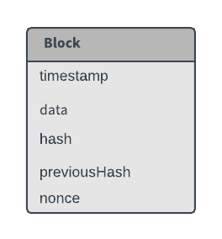
$ git checkout fb23540fce45e0ab0f1a50f7dbb7f839561119ed

Slide 33
Hashing
{4eacc3e94c5bee5c869fdaa1e736096718ff6d50}

Slide 34

Hashing
The hashing function creates 64 characters unique id (SHA-256)
You can use the hash to validate the data
You can’t recreate the data from a hash, it’s a one-way function
010101010101010101010
f(x)
Hash
Value
SHA256
{000df2df78d2f87abf13f648febc3e522649804d701d07aac600f2b265bf5c75}

Slide 35
Hashing
Hash - Is used to sign the block (a checksum) because if you change the info in the block the hash will change
Difficulty - Is the number of times that an established char has to be repeated at the beginning of the hash in order to be valid
Nonce - Is a random number that gets added to the payload in order to obtain a valid hash
Nonce + Difficulty -> forces the hash function to be repeated until it starts with the established numbers of nonce and is impossible guess the nonce number to have the right repetition of a certain number in front the hash.
This is the mathematical problem at the base of the mining and also because is complicated to calculate make sure one single person can’t recalculate the entire chain and rewrite the history in his favor

Slide 36
Hashing
New hash
010101010101010101010
if (repetitionOf(‘0’) == 2)
f(x)
Nonce++
Difficulty: 2
Nonce:100
Valid
Hash
00ec80f6348e70cca8adbddde25ce22ee68e5611f9bbff1caae4d148d137aba5

Slide 37
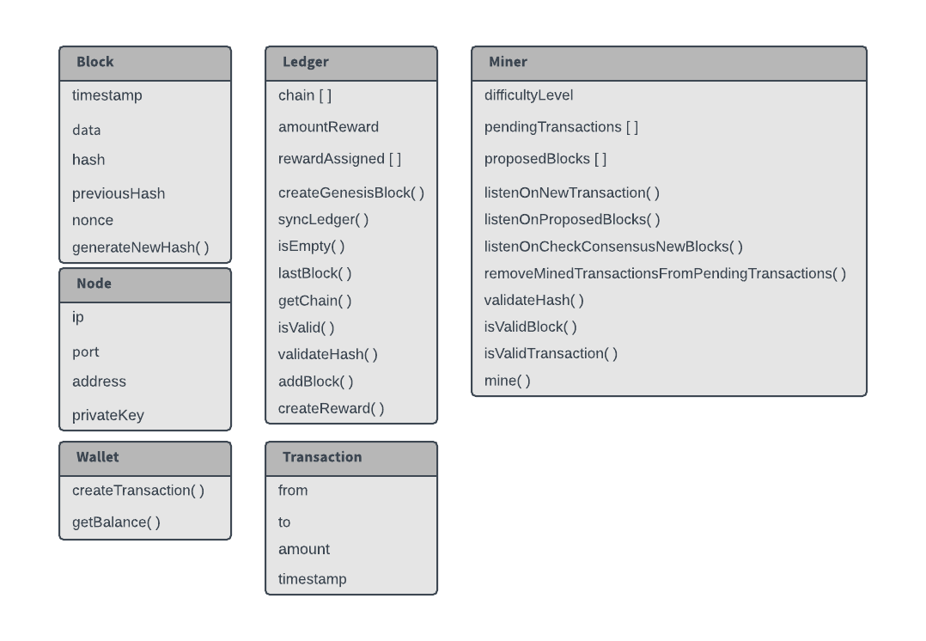
$ git checkout 4eacc3e94c5bee5c869fdaa1e736096718ff6d50

Slide 38
Ledger
{ea08b211ea92529af11520dc24bb86d7fd357a1f}

Slide 39
Ledger
Events storage
If we have 2 conflicting ledger, the longest chain wins, because has most computational power
For this reason a chain is verified only after few blocks (~ 6)
Unless you have more than 50% of the computational power of the network you will not be able to create a longer chain and impose your history

Slide 40
Ledger

Slide 41
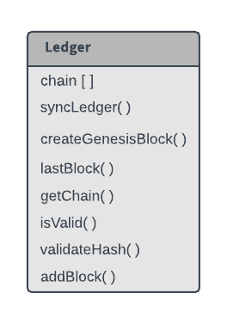
$ git checkout ea08b211ea92529af11520dc24bb86d7fd357a1f

Slide 42

MINING
{5bee1ac50ace79b516276c1d645b66e5e01dcbbd}

Slide 43
Mining
Mining consist in the resolution of a complex mathematical problem (proof of work)
Mining is used to validate transactions and ensure the immutability of the chain
Miners are incentivized with rewards
Mining is used to validate transactions and ensure the immutability of the chain
Miners are specialized nodes

Slide 44
Proof of work
Crypto chain
Miners get a reward for their work (money chain)
Nodes join mining pools in order to have more chances to solve the problem….and then get a fraction of the reward

Slide 45
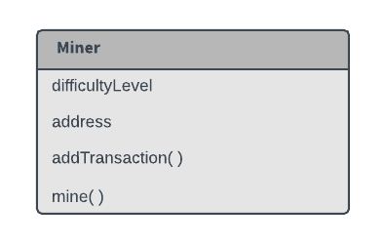
$ git checkout 5bee1ac50ace79b516276c1d645b66e5e01dcbbd

Slide 46

CONSENSUS
{b51eb35378c0114b473a824d9a4e0229a2d8db1e}

Slide 47
Consensus
Blockchain is a distributed system, this means that there is no central authority to validate the transactions in the database
The database is maintained and validated by a large number of computers that offers their computational power and are incentivized through a reward system (mining)
With the consensus (proof of work) the nodes don’t need to trust each other, they need only to trust the mechanism provided by the system
Each computer has a copy of the chain and can validate it

Slide 48
$ git checkout b51eb35378c0114b473a824d9a4e0229a2d8db1e

Slide 49

WALLET
{8ab8dbf24954b9c8648b5418468465746c125af3}
Wallet icon author: Joseph Augustine

Slide 50
$ git checkout 8ab8dbf24954b9c8648b5418468465746c125af3

Slide 51
SMART CONTRACTS
{we don’t cover the code part in this presentation}

Slide 52
Smart contracts
Can be computer code stored and executed in the blockchain
Remove the need for a central authority to create and enforce the contract agreement
The best example of blockchain supporting smart contracts is Ethereum
The contract is immutable and no one can change it (the code is law)
data
data
code
code
hash
hash
genesis
block
block
block
Notes:
Not know how to manage complex situation when rules are less strict and needs a certain degree of jugjments

Slide 53

Smart contracts
For example, 4 people can agree to get some interest when the value of an investment riches a certain value, the code in the smart contract will release the interest automatically to their account when this condition is solidified.
code
==
Smart contract
Wallet icon author: Joseph Augustine
Stock icon author: Giannis Choulakis
Notes:
Not know how to manage complex situation when rules are less strict and needs a certain degree of jugjments

Slide 54
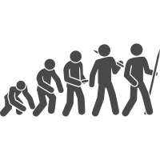
Blockchain Evolution
Evolution icon author: Jakob Vogel

Slide 55

Blockchain Evolution
Web 3.0
Blockchain 1.0
Ledger record transactions
Blockchain 2.0
Smart Contracts
Blockchain 3.0
Distributed cloud computer
2007
2010
2013
2016
2019
Notes:
In order to get to Blockchain 3.0 we still have to solve some challenges about scalability and sustenability of the proof of work, it may will require to switch to other system…like proof of stake

Slide 56



WEB Evolution
Read Only
Read and Write
centralized information
Read and Write
decentralized information
Web 1.0
Web 2.0
Web 3.0
King icon author: Sharon Showalter

Slide 57
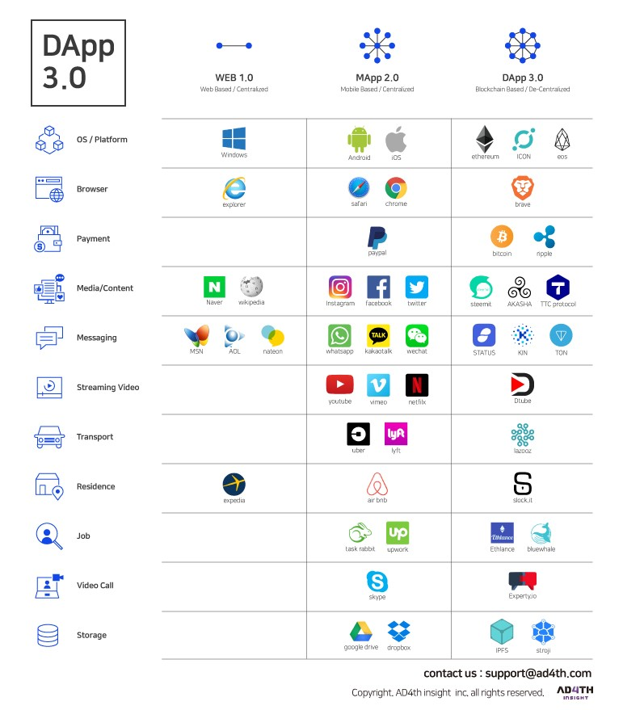
WEB 3.0

Slide 58
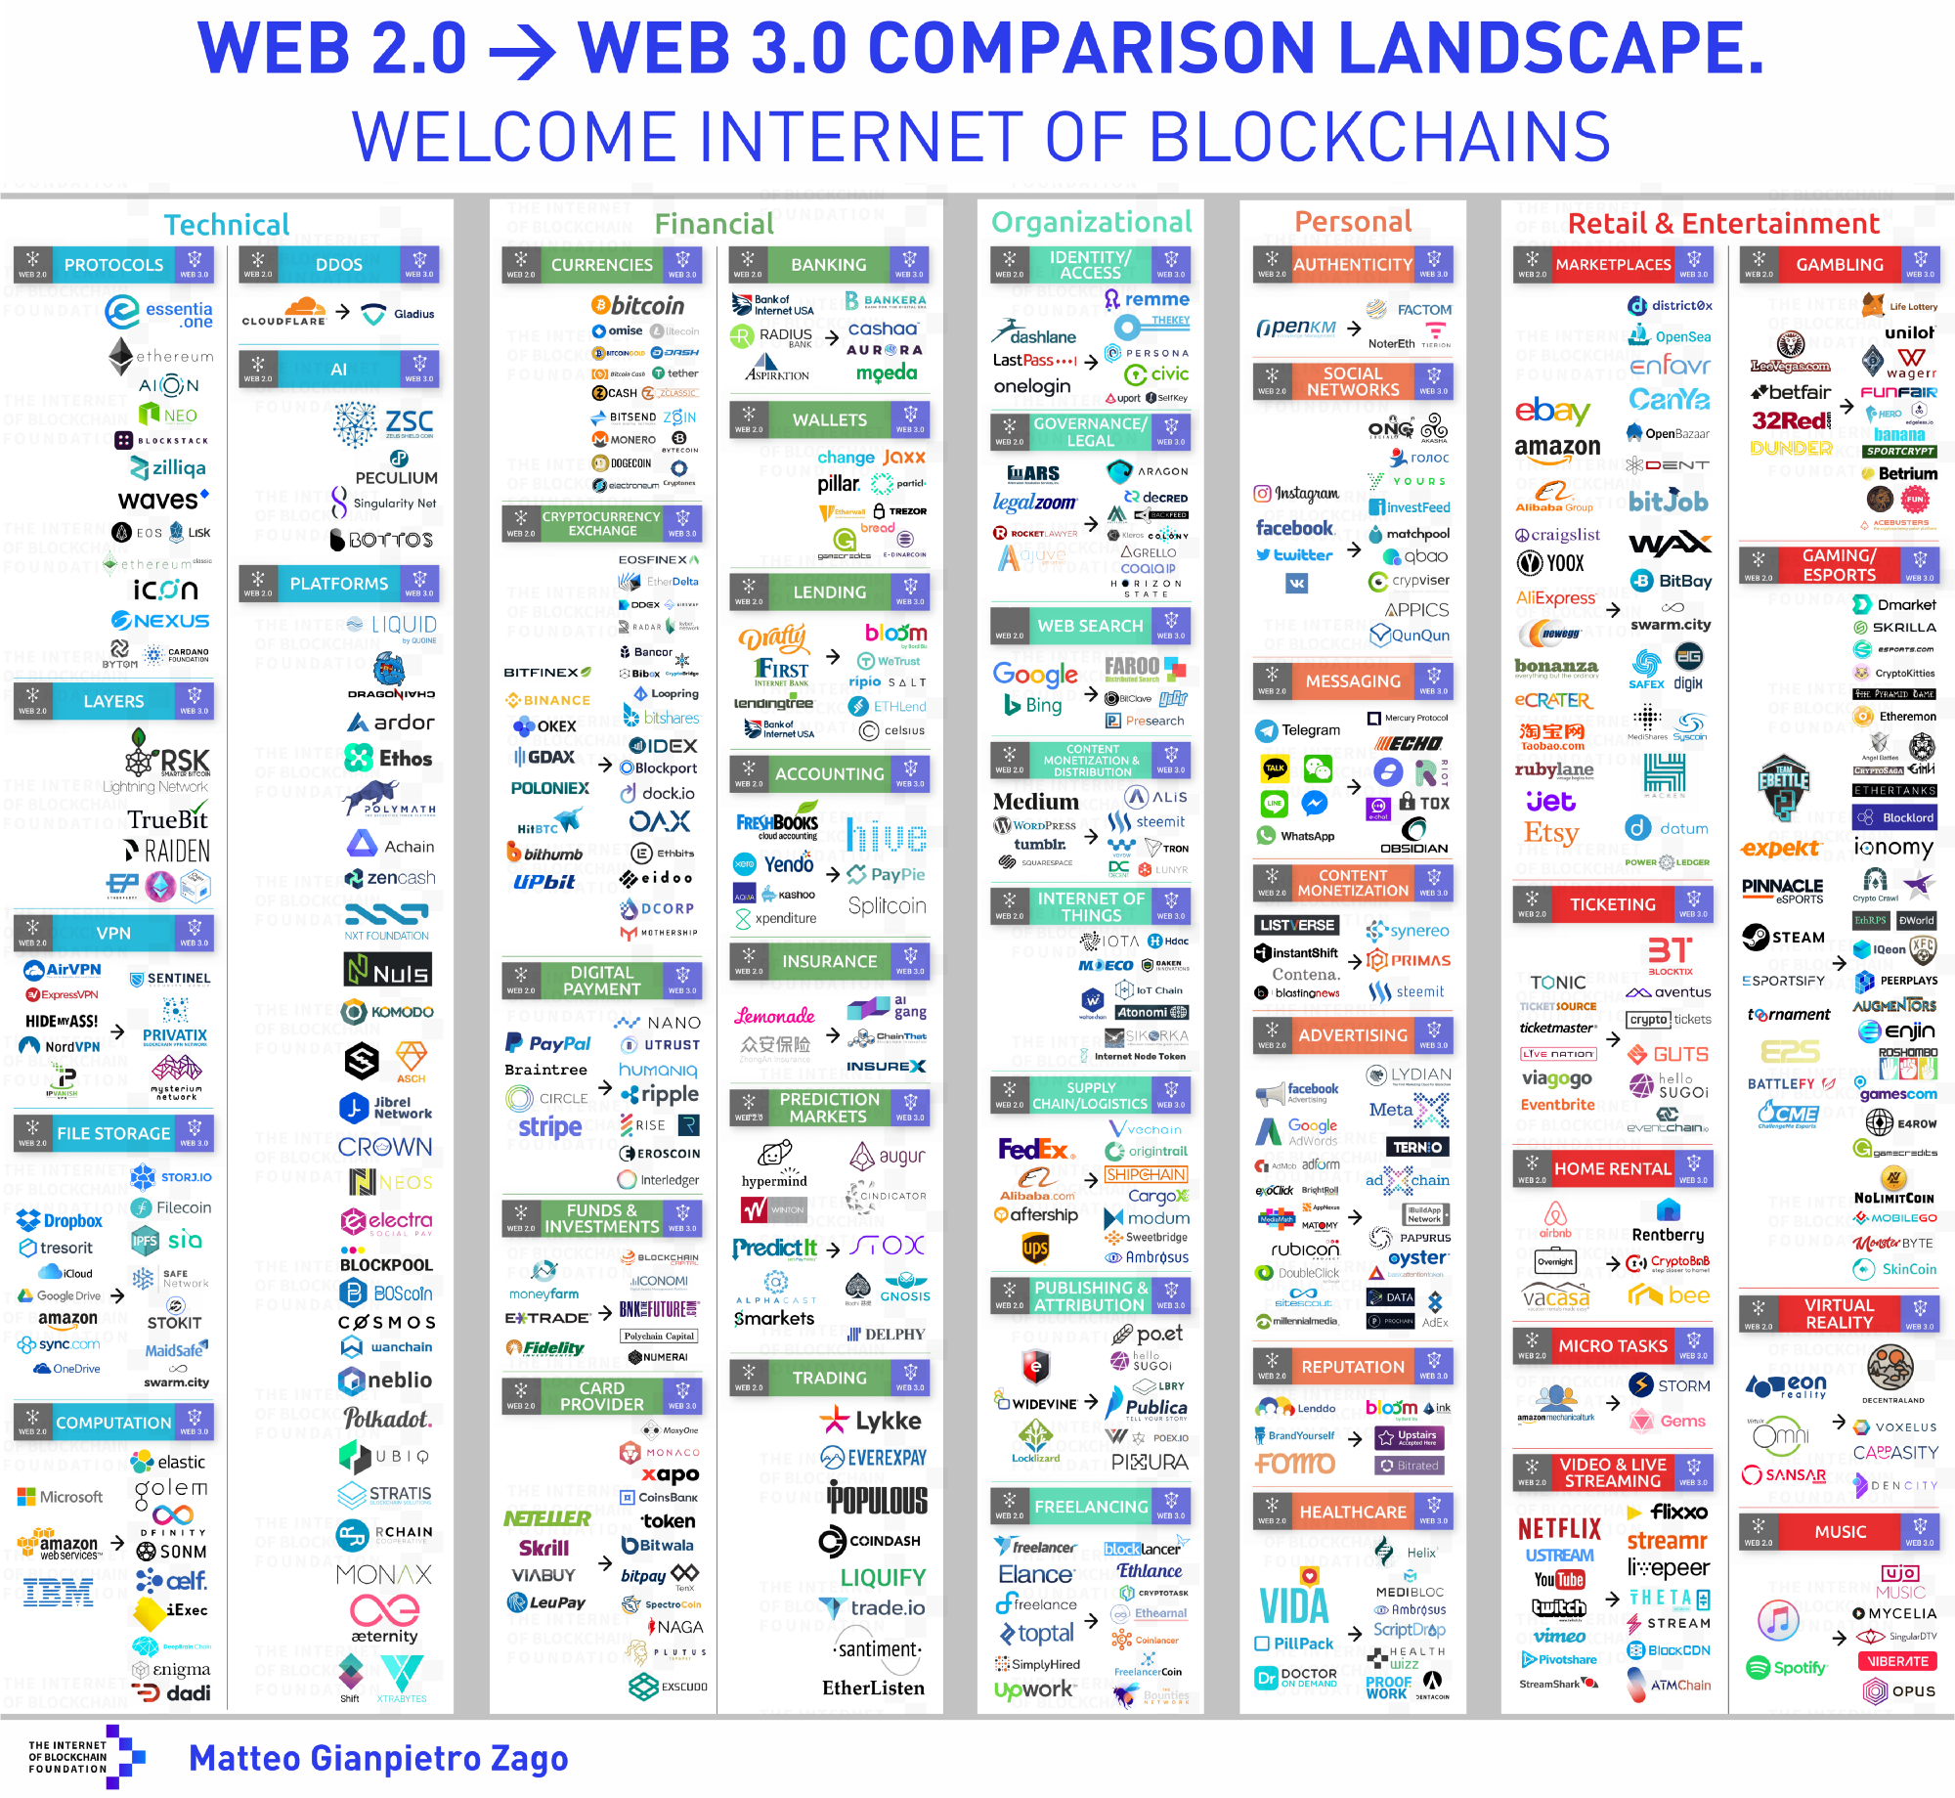
Notes:
All companies working on Blockchain projects

Slide 60
DON’T TRY THIS AT HOME

Slide 61
Notes:
Missing signature on transaction….next demo ☺

Slide 62
Q&A
https://github.com/magemello/blockchain
Notes:
Why we want to decentralize?
Upgrade peers problem?
Use cases for blockchain?
Decentralizers vs Centralizers….reasons?
Decentralizers vs Centralizers pro cons?
Blockchain limiits?-> Transactions per second? Size Block?

